Slide 1
HTTP Protocol
Overview of the HTTP protocol for web developers

Slide 2
Learning outcome
After this lesson you will know which role the HTTP plays in developing Web based applications.
You will be able to examine the HTTP requests and responses and know about the most important elements of the headers.

Slide 3
Agenda
HTTP Protocol
HTTP Basics
HTTP Verbs
Status Codes
Message Formats
Headers and Body
Tools (Postman, Fiddler, Google Chrome)
Exercise

Slide 4
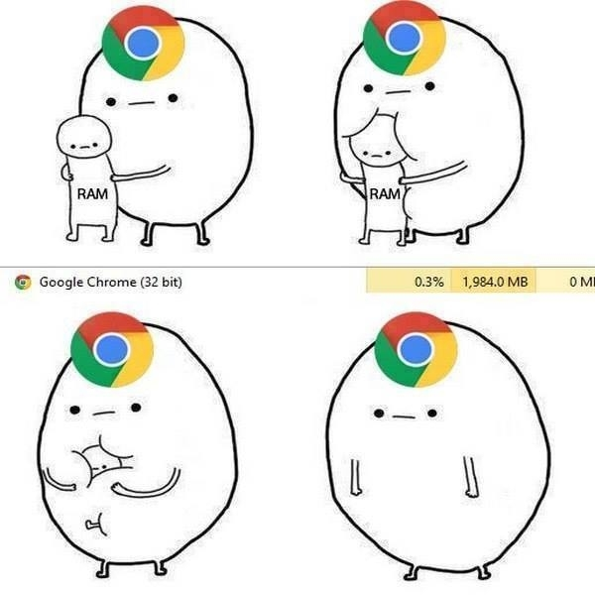
A Browser can only do 3 things
Show HTML
Apply CSS
Run JavaScript
All other is in general performed on server. Including Razor, ASP.NET tags etc.

Slide 5
HTTP Basics
HTTP Protocol

Slide 6
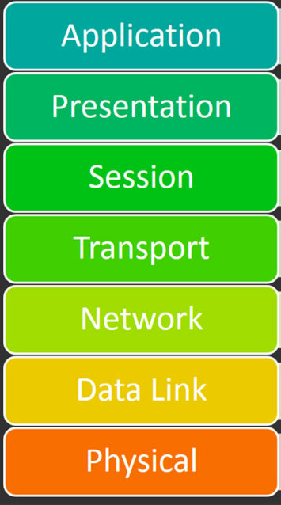
HTTP Basics
HTTP stands for Hypertext Transfer Protocol. It's a stateless, application-layer protocol for communicating between distributed systems, and is the foundation of the modern web.
As a web developer, we all must have a strong understanding of this protocol.
The HTTP Protocol is the foundation of Web development, including web services.

Slide 7
HTTP Basics
HTTP allows for communication between a variety of hosts and clients, and supports a mixture of network configurations.
To make this possible, it assumes very little about a particular system, and does not keep state between different message exchanges.
This makes HTTP a stateless protocol.
Usually communicates using TCP/IP protocol, the default port is: 80

Slide 8




HTTP Basics
Request
Response

Slide 9
Basic HTTP
Communication between a host and a client occurs, via a request/response pair.
The client initiates an HTTP request message, which is serviced through a HTTP response message in return.
When a response is received it contains a set of headers and a body (we look at this later).
The browser interprets the header and body and creates the layout of the web site.

Slide 10
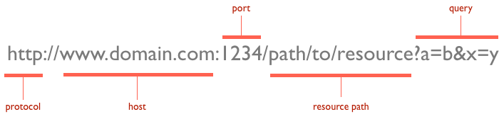
HTTP Basics
At the heart of web communications is the request message, which are sent via Uniform Resource Locators (URLs).

Slide 11
HTTP Verbs
HTTP Protocol

Slide 12
HTTP Verbs
An URL specify the host with which we want to communicate with.
An URL also defines the ressource and the query/parameters that is sent to that host and that ressource.
The action / command the host received is specified by the HTTP Verb.

Slide 13
HTTP Verbs
We can imagine all sorts of actions / commands that a host need to perform.
The HTTP protocol has reduced this to a few that capture the essentials.
These essential verbs is universally applicable for all kinds of applications.

Slide 14
HTTP Verbs
GET: fetch an existing resource. The URL contains all the necessary information the server needs to locate and return the resource.
POST: create a new resource. POST requests usually carry a payload that specifies the data for the new resource.
PUT: update an existing resource. The payload may contain the updated data for the resource.
DELETE: delete an existing resource.

Slide 15
HTTP Verbs
Sometimes the DELETE and the PUT are considered specialized versions of the POST verb.
These 4 basic verbs build up the backbone of a set of CRUD operations.
Operation | HTTP Verb
CREATE | POST (PUT)
READ | GET
UPDATE | PUT (POST)
DELETE | DELETE

Slide 16
HTTP STATUS CODES
HTTP Protocol

Slide 17
HTTP Status Codes
With URLs and verbs, the client can initiate requests to the server
In return, the server responds with status codes and message payloads
The status code is important and tells the client how to interpret the server response
The HTTP protocol defines certain number ranges for specific types of responses

Slide 18
HTTP Status Codes
2xx: Successful
This tells the client that the request was successfully processed. The most common code is 200 OK. For a GET request, the server sends the resource in the message body. There are other less frequently used codes:
202 Accepted: the request was accepted but may not include the resource in the response. This is useful for async processing on the server side. The server may choose to send information for monitoring.
204 No Content: there is no message body in the response.
205 Reset Content: indicates to the client to reset its document view.
206 Partial Content: indicates that the response only contains partial content. Additional headers indicate the exact range and content expiration information.

Slide 19
HTTP Status Codes
3xx: Redirection
This requires the client to take additional action. The most common use-case is to jump to a different URL in order to fetch the resource.
301 Moved Permanently: the resource is now located at a new URL.
302 Moved Temporarily: The page has temporaily been moved (it was found)
303 See Other: the resource is temporarily located at a new URL. The Location response header contains the temporary URL.
304 Not Modified: the server has determined that the resource has not changed and the client should use its cached copy.

Slide 20
HTTP Status Codes
4xx Client Error
These codes are used when the server thinks that the client is at fault, either by requesting an invalid resource or making a bad request. The most popular code in this class is 404 Not Found, which I think everyone will identify with. 404 indicates that the resource is invalid and does not exist on the server. The other codes in this class include:
400 Bad Request: the request was malformed.
401 Unauthorized: request requires authentication. The client can repeat the request with the Authorization header. If the client already included the Authorization header, then the credentials were wrong.
403 Forbidden: server has denied access to the resource.

Slide 21
HTTP Status Codes
5xx: Server Error
This class of codes are used to indicate a server failure while processing the request. The most commonly used error code is 500 Internal Server Error. The others in this class are:
501 Not Implemented: the server does not yet support the requested functionality.
503 Service Unavailable: this could happen if an internal system on the server has failed or the server is overloaded. Typically, the server won't even respond and the request will timeout.

Slide 22
HTTP Message formats
HTTP Protocol

Slide 23
HTTP Request / Response
1: Request (URL + VERB)
2: Response (Status code + Body)

Slide 24
Message Formats
The HTTP specification states that a request or response message has a set of headers and a body.
The body can typically be HTML or in web services it could be JSON or HTML
The header is divided into several groups:
General Headers – shared for both request and response.
Request Specific Headers – headers specific to the request
Response Specific Headers – headers specific to the response
Entity Headers – headers that help interpret the content

Slide 25
Message Formats
The entity headers contain meta information about the content, these are known as content headers, the most important ones are below:
Content-Encoding - encoding e.g. gzip
Content-Language - language e.g. da
Content-Length – length e.g. 42.000 bytes
Content-Type – type e.g. html/text, json, xml
Expires – date and time for expiration of the response
Last-Modified – when was the content modified

Slide 26
Message Formats
Both the client and the server can specify content-type:
Client – defines which type of content it would like to receive (especially important with webservices)
Server – meta information about what was delivered.
By default a browser will ask a website for getting content of type text/html. It will then render the content.
Each subsequent request to images, css, js etc. Will request using the proper content-type.

Slide 27
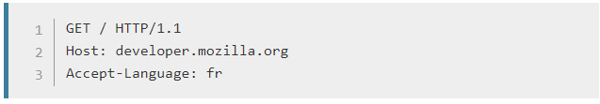
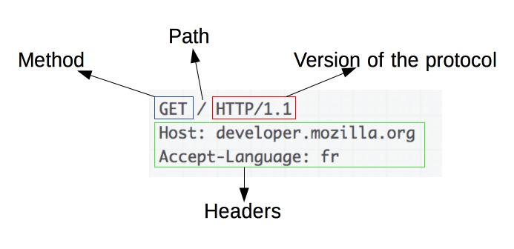
HTTP flow
1. Open a TCP connection
2. Send an HTTP request message:

Slide 28
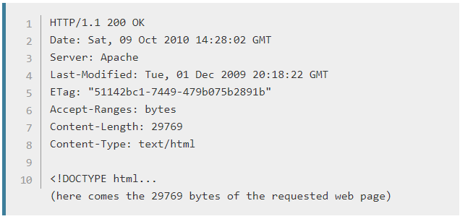
HTTP flow
3. Read the response sent by the server:
4. Close or reuse the connection for further requests

Slide 29
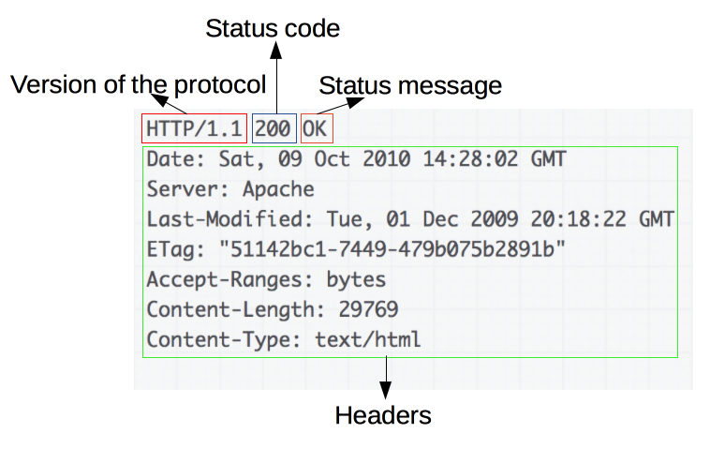
HTTP flow

Slide 30
Tools – google chrome
HTTP Protocol

Slide 31
Google Chrome
Google Chrome contains a highly sophisticated debugginf and diagnostics tool for debugging a website.
Fiddler is a powerfull tool to monitor traffic to and from a website.
Postman is a tool for sending GET, PUT, POST and DELETE commands to an URL.
Pressing F12 in Google opens up the developer tools for Google

Slide 32
Google Chrome
5 important tabs in Google Chrome Developer tools.
Elements – the content of the web site
Console – the debugging console
Sources – The source files (JavaScript)
Network – the network traffic
Timeline – the time for displaying the web site

Slide 33
Exercises
HTTP Protocol

Slide 34
Exercises
Examine the network traffic for ucn.dk. What happens when you access ucn.dk (status codes etc.)
What size is the ucn.dk and how long time does it take for the site to load.
What kind of encoding does ucn.dk respond with.
How many requests does the ucn.dk have?
The web agency that made ucn.dk – did they leave debug messages?
Start fiddler and try loading ucn.dk again – what happens and why?
Load greenweb.dk – what headers are set on that response (use fiddler)

